Slide 1
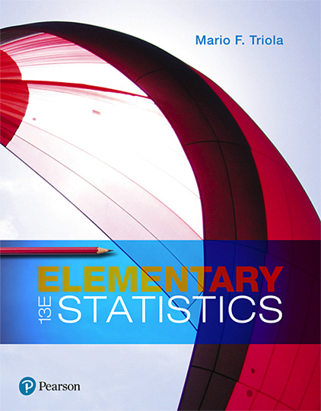
Elementary Statistics
Thirteenth Edition
Chapter 9
Inferences from Two Samples
Copyright © 2018, 2014, 2012 Pearson Education, Inc. All Rights Reserved

Slide 2
Inferences from Two Samples
9-1 Two Proportions
9-2 Two Means: Independent Samples
9-3 Two Dependent Samples (Matched Pairs)
9-4 Two Variances or Standard Deviations

Slide 3
Key Concept
In this section we present methods for (1) testing a claim made about two population proportions and (2) constructing a confidence interval estimate of the difference between two population proportions. The methods of this chapter can also be used with probabilities or the decimal equivalents of percentages.

Slide 4
Inferences About Two Proportions: Objectives
Objectives
​​​Hypothesis Test: Conduct a hypothesis test of a claim about two population proportions.
​​​​Confidence Interval: Construct a confidence interval estimate of the difference between two population proportions.

Slide 5
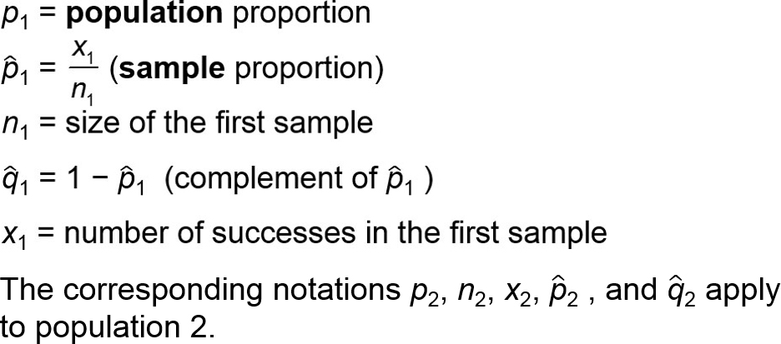
Inferences About Two Proportions: Notation for Two Proportions
For population 1 we let

Slide 6
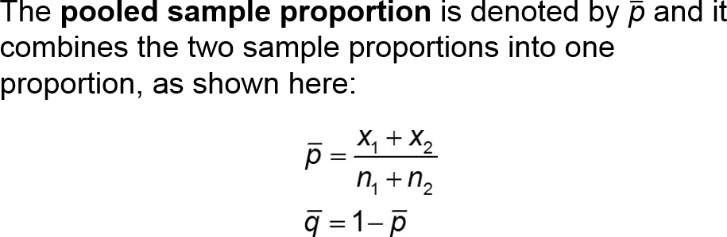
Inferences About Two Proportions: Pooled Sample Proportion

Slide 7
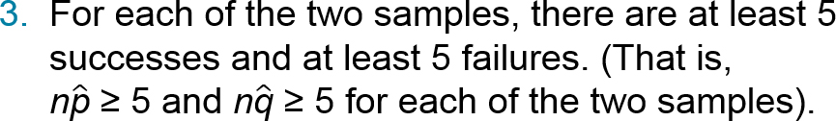
Inferences About Two Proportions: Requirements
The sample proportions are from two simple random samples.
The two samples are independent. (Samples are independent if the sample values selected from one population are not related to or somehow naturally paired or matched with the sample values from the other population.)

Slide 8
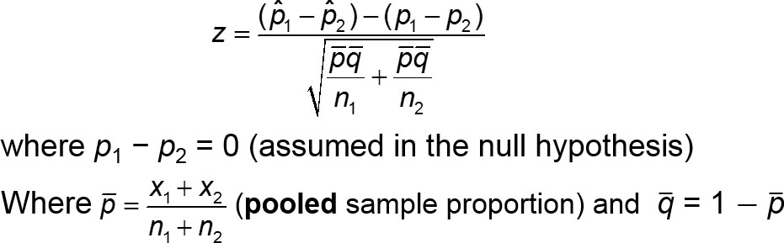
Inferences About Two Proportions: Test Statistic for Two Proportions (with H₀: p₁ = p₂)

Slide 9
P-Value and Critical Values
P-Value: P-values are automatically provided by technology. If technology is not available, use Table A-2 (standard normal distribution) and find the P-value using the procedure given in Figure 8-3 on page 364.
Critical Values: Use Table A-2. (Based on the significance level α, find critical values by using the same procedures introduced in Section 8-1.)

Slide 10
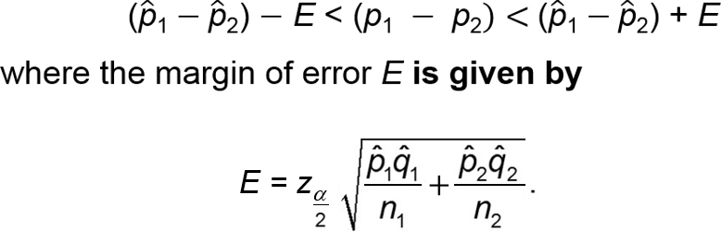
Confidence Interval Estimate of p₁ − p₂ = 0
The confidence interval estimate of the difference p₁ − p₂ is

Slide 11
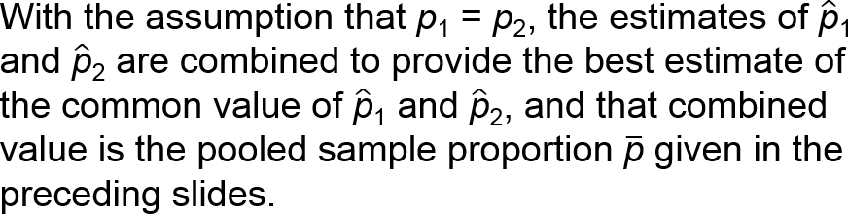
Hypothesis Tests
For tests of hypotheses made about two population proportions, we consider only tests having a null hypothesis of p₁ = p₂ (so the null hypothesis is H₀ : p₁ = p₂).

Slide 12
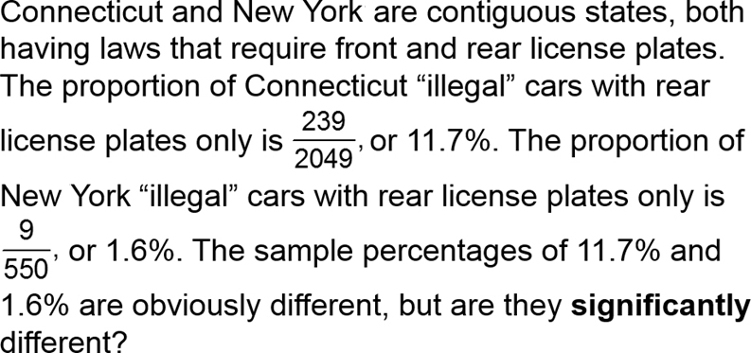
Example: Proportions of Cars with Rear License Plates Only: Are the Proportions the Same in Connecticut and New York? (1 of 14)

Slide 13
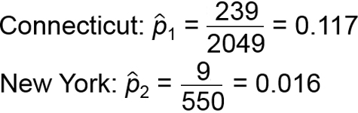
Example: Proportions of Cars with Rear License Plates Only: Are the Proportions the Same in Connecticut and New York? (2 of 14)
Blank | Connecticut | New York
Cars with rear license plate only | 239 | 9
Cars with front and rear license plates | 1810 | 541
Total | 2049 | 550
Use a 0.05 significance level and the P-value method to test the claim that Connecticut and New York have the same proportion of cars with rear license plates only.

Slide 14
Example: Proportions of Cars with Rear License Plates Only: Are the Proportions the Same in Connecticut and New York? (3 of 14)
Solution
Requirement Check (1) The two samples are simple random samples (trust the author!). (2) The two samples are independent because cars in the samples are not matched or paired in any way. (3) Let’s consider a “success” to be a car with a rear license plate only. For Connecticut, the number of successes is 239 and the number of failures (cars with front and rear license plates) is 1810, so they are both at least 5. For New York, there are 9 successes and 541 failures, and they are both at least 5. The requirements are satisfied.

Slide 15
Example: Proportions of Cars with Rear License Plates Only: Are the Proportions the Same in Connecticut and New York? (4 of 14)
Solution
Step 1: The claim that “Connecticut and New York have the same proportion of cars with rear license plates only” can be expressed as p₁ = p₂.
Step 2: If p₁ = p₂ is false, then p₁ ≠ p₂.
Step 3: Because the claim of p₁ ≠ p₂ does not contain equality, it becomes the alternative hypothesis. The null hypothesis is the statement of equality, so we have
H₀: p₁ = p₂ H₁: p₁ ≠ p₂

Slide 16
Example: Proportions of Cars with Rear License Plates Only: Are the Proportions the Same in Connecticut and New York? (5 of 14)
Solution
Step 4: The significance level was specified as α = 0.05, so we use α = 0.05.
Step 5: This step and the following step can be circumvented by using technology; see the display that follows this example. If not using technology, we use the normal distribution as an approximation to the binomial distribution.

Slide 17
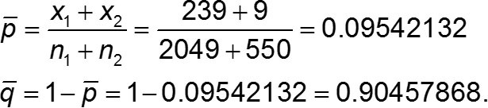
Example: Proportions of Cars with Rear License Plates Only: Are the Proportions the Same in Connecticut and New York? (6 of 14)
Solution
Step 5 (con’t): We estimate the common value of p₁ and p₂ with the pooled sample estimate p calculated as shown below, with extra decimal places used to minimize rounding errors in later calculations.

Slide 18
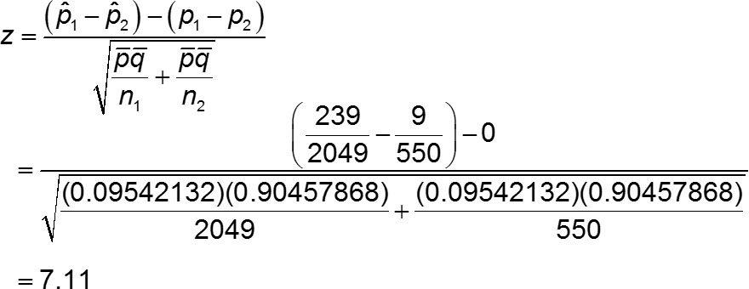
Example: Proportions of Cars with Rear License Plates Only: Are the Proportions the Same in Connecticut and New York? (7 of 14)
Solution
Step 6: Because we assume in the null hypothesis that p₁ = p₂, the value of p₁ − p₂ is 0 in the following calculation of the test statistic:

Slide 19
Example: Proportions of Cars with Rear License Plates Only: Are the Proportions the Same in Connecticut and New York? (8 of 14)
Solution
Step 6 (con’t): This is a two-tailed test, so the P-value is twice the area to the right of the test statistic z = 7.11. Refer to Table A-2 and find that the area to the right of the test statistic z = 7.11 is 0.0001, so the P-value is 0.0002. Technology provides a more accurate P-value of 0.00000000000119, which is often expressed as 0.0000 or “P-value < 0.0001.”

Slide 20
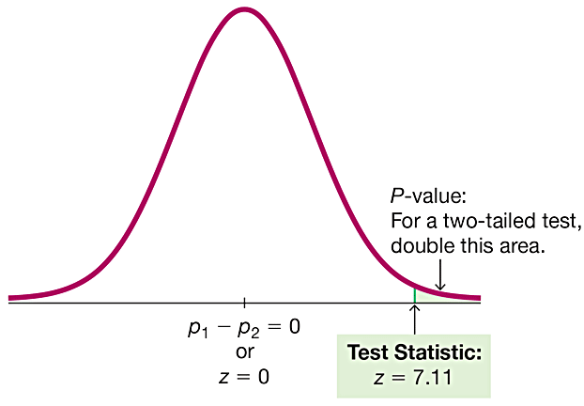
Example: Proportions of Cars with Rear License Plates Only: Are the Proportions the Same in Connecticut and New York? (9 of 14)
Solution

Slide 21
Example: Proportions of Cars with Rear License Plates Only: Are the Proportions the Same in Connecticut and New York? (10 of 14)
Solution
Step 7: Because the P-value of 0.0000 is less than the significance level of α = 0.05, we reject the null hypothesis of p₁ = p₂.

Slide 22
Example: Proportions of Cars with Rear License Plates Only: Are the Proportions the Same in Connecticut and New York? (11 of 14)
Interpretation
We must address the original claim that “Connecticut and New York have the same proportion of cars with rear license plates only.” Because we reject the null hypothesis, we conclude that there is sufficient evidence to warrant rejection of the claim that p₁ = p₂. That is, there is sufficient evidence to conclude that Connecticut and New York have different proportions of cars with rear license plates only. It’s reasonable to speculate that enforcement of the license plate laws is much stricter in New York than in Connecticut, and that is why Connecticut car owners are less likely to install the front license plate.

Slide 23
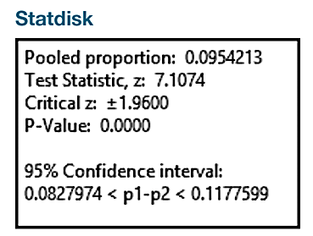
Example: Proportions of Cars with Rear License Plates Only: Are the Proportions the Same in Connecticut and New York? (12 of 14)
Technology
Software and calculators usually provide a P-value, so the P-value method is typically used for testing a claim about two proportions. See the Statdisk results showing the test statistic of z = 7.11(rounded) and the P-value of 0.0000.

Slide 24
Example: Proportions of Cars with Rear License Plates Only: Are the Proportions the Same in Connecticut and New York? (13 of 14)
Solution (Critical Value Method)
The critical value method of testing hypotheses can also be used. In Step 6, find the critical values. With a significance level of α = 0.05 in a two-tailed test based on the normal distribution, we refer to Table A-2 and find that an area of α = 0.05 divided equally between the two tails corresponds to the critical values of z = ±1.96.

Slide 25
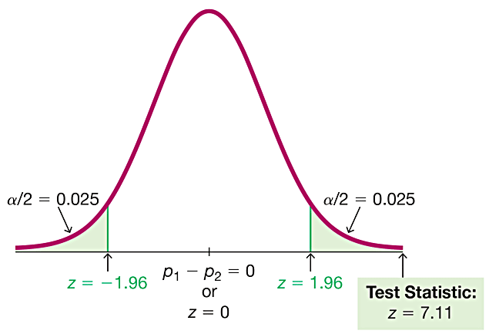
Example: Proportions of Cars with Rear License Plates Only: Are the Proportions the Same in Connecticut and New York? (14 of 14)
Solution (Critical Value Method)
We can see that the test statistic of z = 7.11 falls within the critical region beyond the critical value of 1.96. We again reject the null hypothesis. The conclusions are the same.

Slide 26
Example: Confidence Interval for Claim About Two Proportions (1 of 5)
Use the same sample data given to construct a 95% confidence interval estimate of the difference between the two population proportions. What does the result suggest about the claim that “Connecticut and New York have the same proportion of cars with rear license plates only”?

Slide 27
Example: Confidence Interval for Claim About Two Proportions (2 of 5)
Solution
Requirement Check We are using the same data and the same requirement check applies here. The confidence interval can be found using technology.

Slide 28
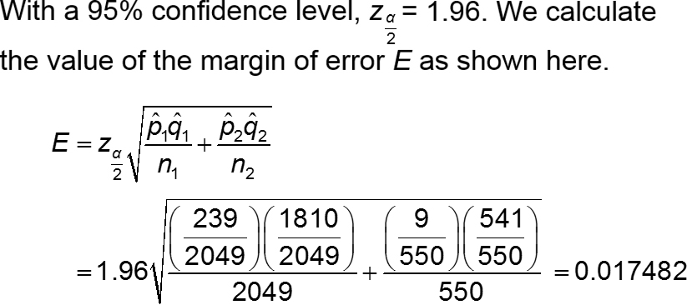
Example: Confidence Interval for Claim About Two Proportions (3 of 5)
Solution
If not using technology, proceed as follows.

Slide 29
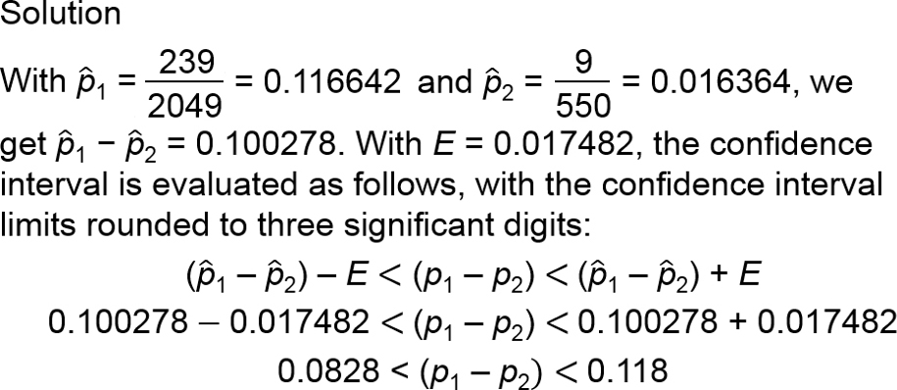
Example: Confidence Interval for Claim About Two Proportions (4 of 5)
See the preceding Statdisk display showing the same confidence interval obtained here.

Slide 30
Example: Confidence Interval for Claim About Two Proportions (5 of 5)
Interpretation
The confidence interval limits do not contain 0, suggesting that there is a significant difference between the two proportions. The confidence interval suggests that the value of p₁ is greater than the value of p₂, so there does appear to be sufficient evidence to warrant rejection of the claim that “Connecticut and New York have the same proportion of cars with rear license plates only.”

